Slide 1

DEAD END by Barcelona24

Slide 2
Team project
Are you able to defend yourself against a zombie attacks?
If you like shooting games, you will like this too
Link to the game:
https://github.com/enoxum/UbiBelPMF_2024/tree/DeadEnd

Slide 3
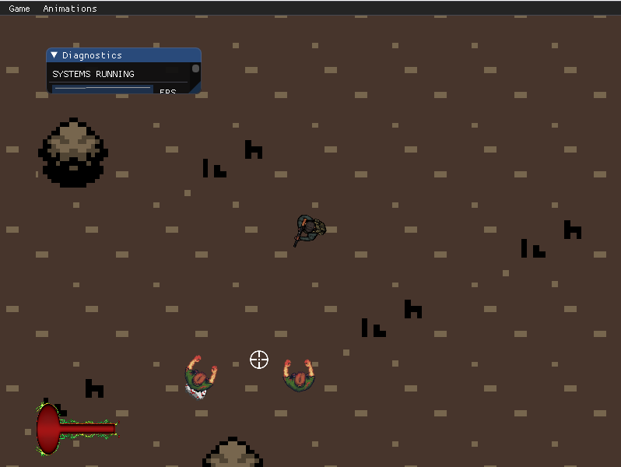
screenshots
The zombies are coming after you!

Slide 4
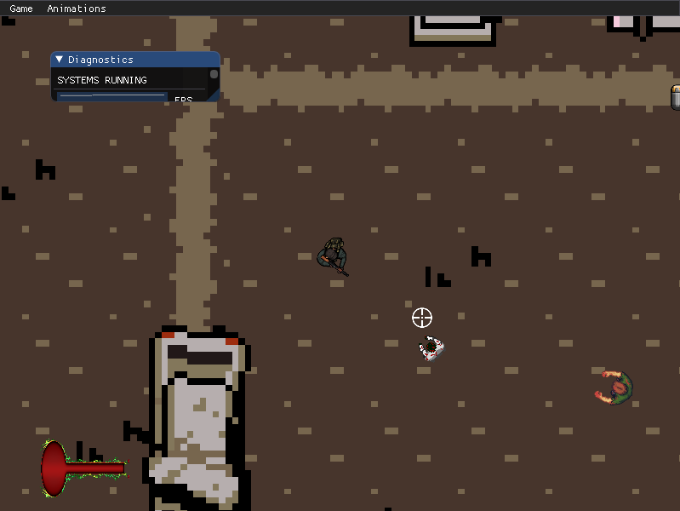
screenshots
Battling in the first wave
Notes:
Race begins, player 2 in the lead.

Slide 5
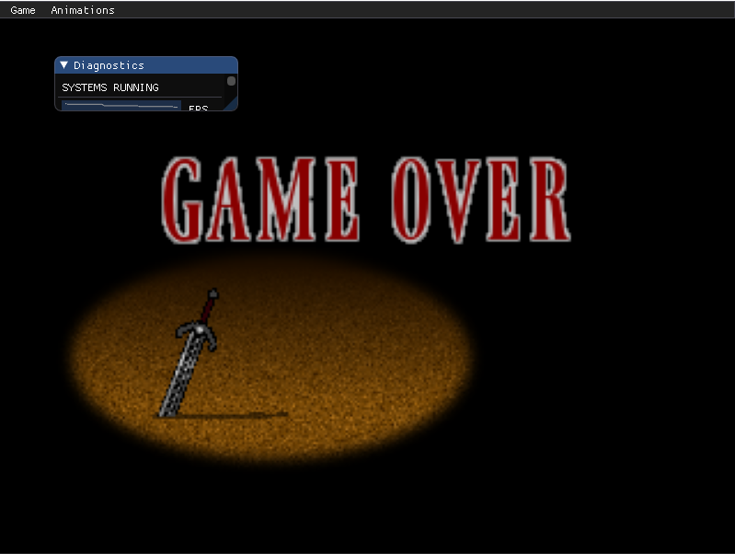
screenshots
End screen

Slide 6
Team members
Milos Obrenovic
Marko Paunovic
Stefan Kerkoc
Petra Ignjatovic

Slide 7
Game description
Zombies are attacking in 4 waves. You have to beat the final boss in the end.
The game is situated in a post-apocalyptic world
As the game progresses you get upgrade of weapons to help you fight back

Slide 8
Game description
You have different types of enemies and obstacles on the map
You can restore your health with a collectable

Slide 9
Game features
Controls: Players can move by using WASD
Shooting : Spacebar
Aiming: Mouse control Implemented by Milos

Slide 10
Game features
Health system, collectables, wavestruct
Implemented by Petra

Slide 11
Game features
Maps and obstacles
Implemented by Marko

Slide 12
Game features
Enemy system
Implemented by Stefan
Notes:
]

Slide 13
Postmortem
What went well?
Implementing the player class
Map generation

Slide 14
Postmortem
Features not implemented:
We wanted more collectables to be there
Ability to change weapons mid-game

Slide 15
Postmortem
What went wrong?
Cursor integration and shooting system were tricky
Weird recoil effect with every bullet fired

Slide 16
Postmortem
If we could start over, we would:
Try to better organize time and set our deadlines better

Slide 17
Postmortem
Some of the great additions to dagger would be:
We don’t know ☺

Slide 18
Postmortem
What have we learned?
The best thing was seeing our game coming alive and giving it to our friends to test it
Some of us are looking for a career in game development

Slide 19
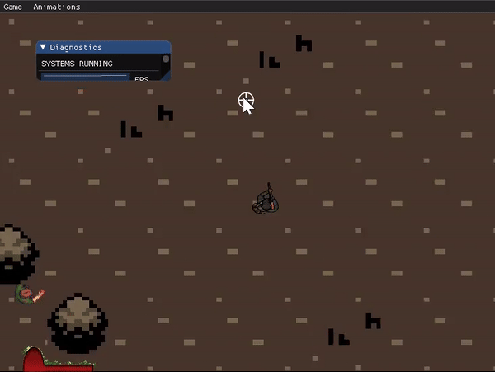
gif

Slide 20
Thank you!

Slide 21
Questions

